Slide 1

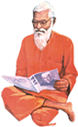
Swami Keshvanand Institute of Technology, Management & Gramothan, Jaipur
(An Autonomous Institute Affiliated to Rajasthan Technical University, Kota)
Industrial Training
Presentation
Cricket Player Performance Analyzer
Submitted To
Mrs. Priya Gupta
Assistant Professor
Submitted By
Isha Agrawal (23ESKCY021)
Eshan Rathore (23ESKCY015)

Slide 2

Company Introduction
COPLUR plays a vital role in bridging the gap between organizations and students by offering practical, job-oriented courses developed alongside industry experts. By focusing on the needs of both learners and employers, we foster an environment where talented individuals can thrive. Our dedication to providing skilled resources and guaranteeing placements empowers both students and organizations, ensuring they are well-prepared to achieve success in their respective fields.

Slide 3
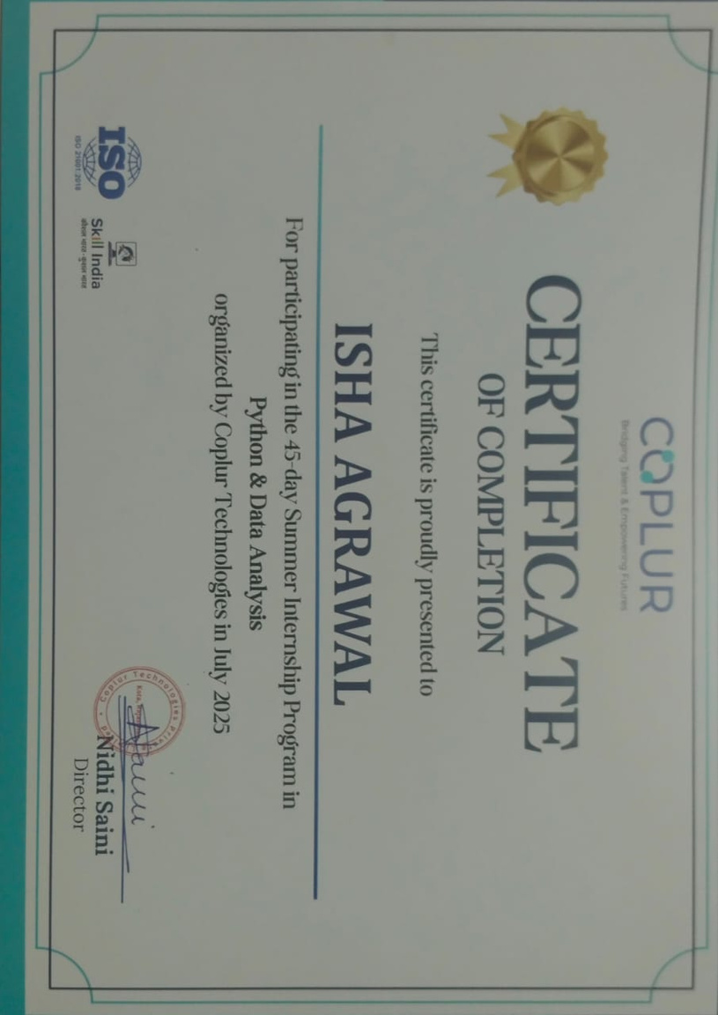
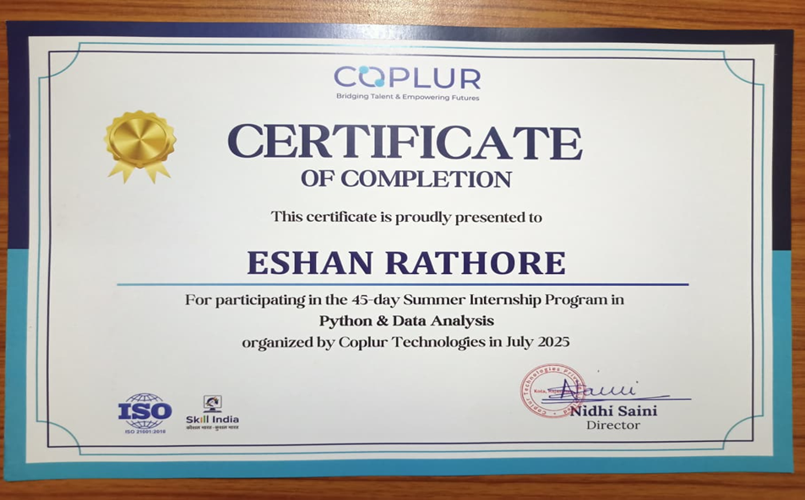
Certificates

Slide 4




Cricket Player Analyzer Overview

Slide 5


Project Overview
01
Project Structure
02
Index
Frontend Features
03
Backend Features
04
Data Source
05

Slide 6
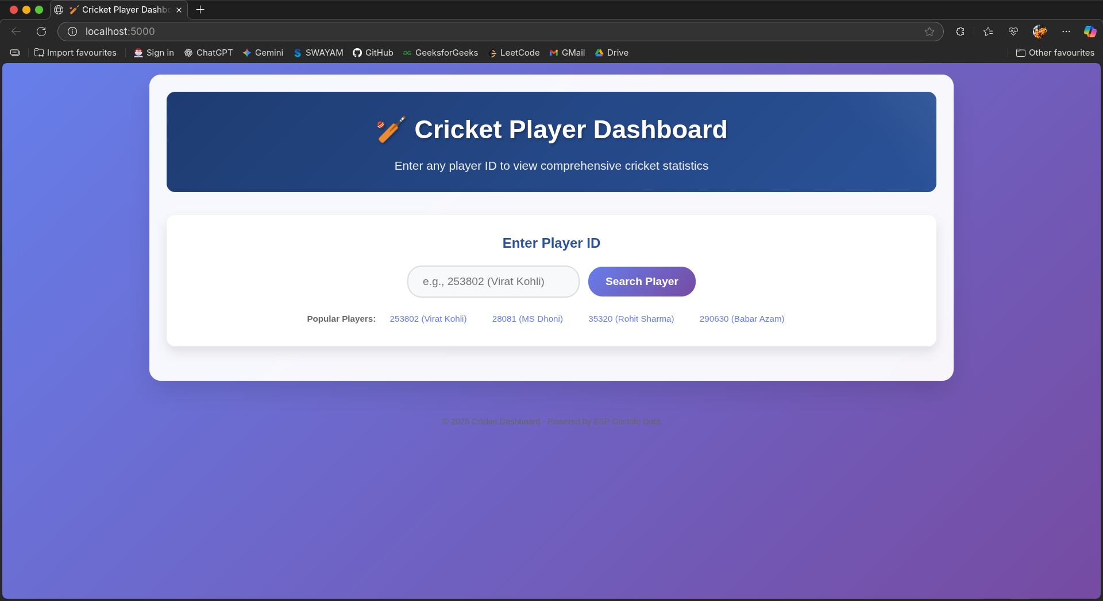

Slide 7
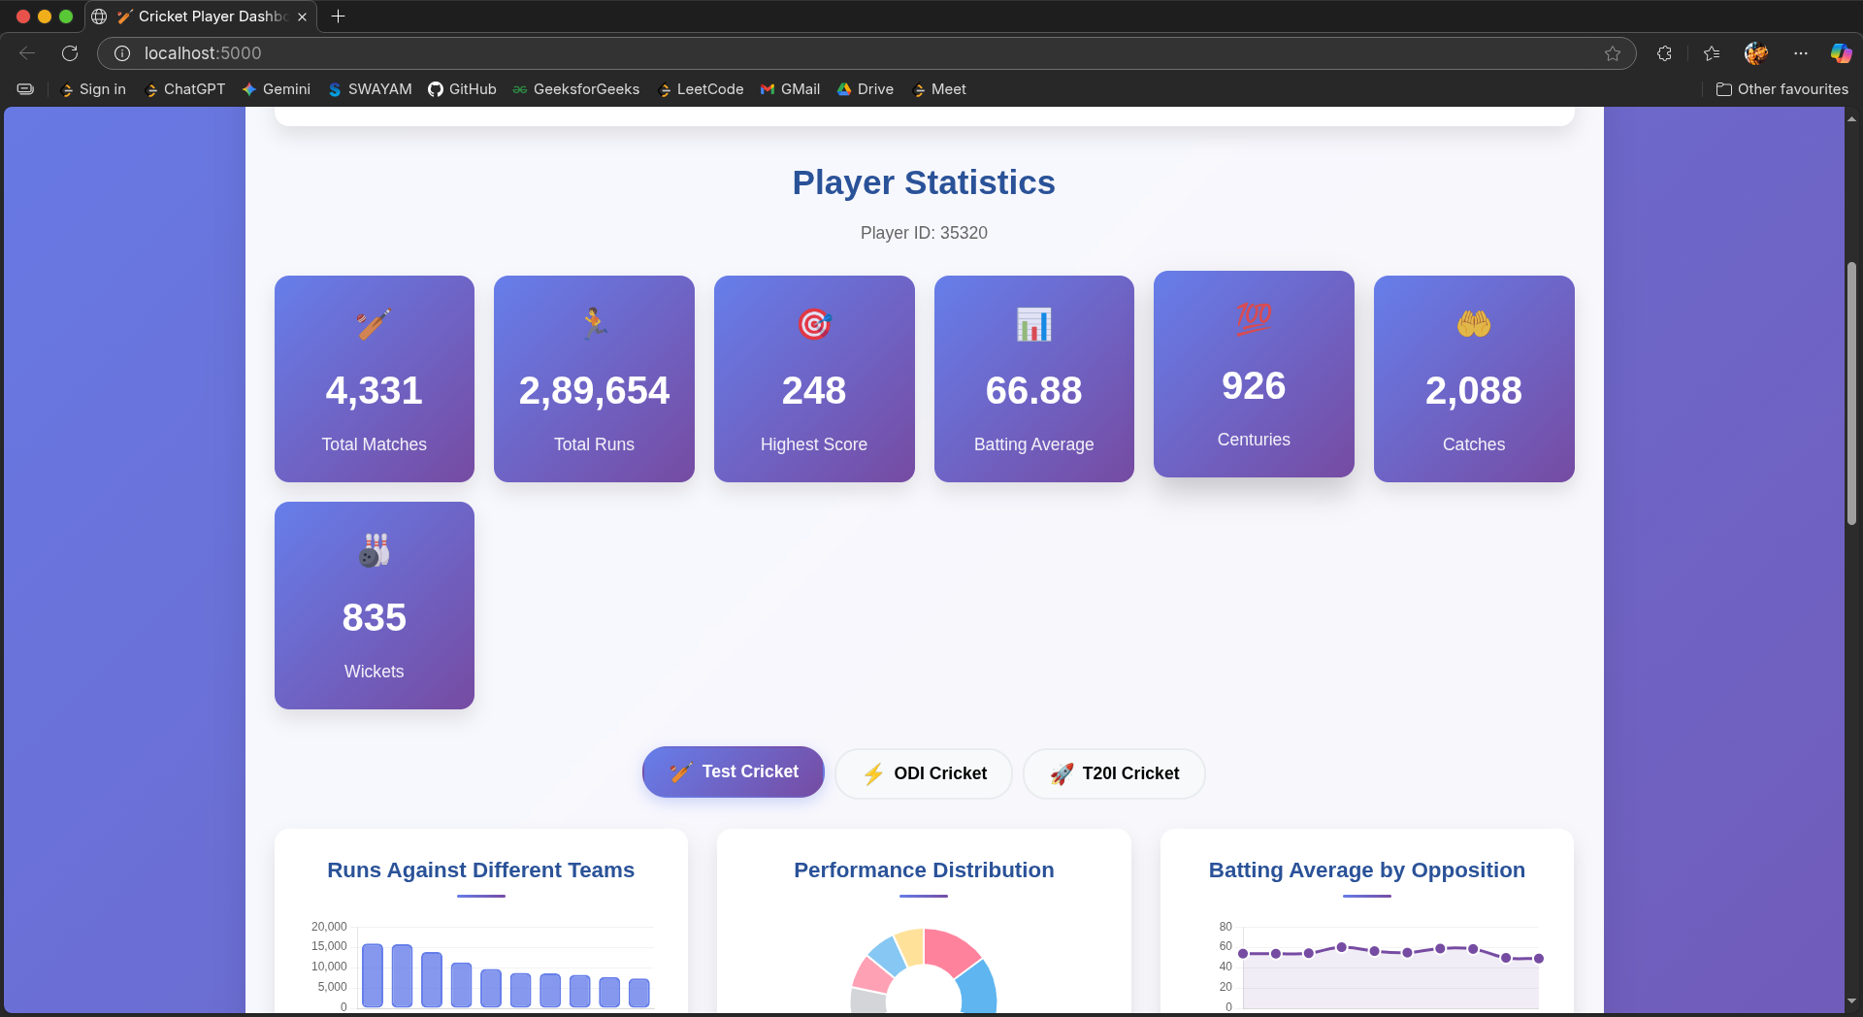

Slide 8
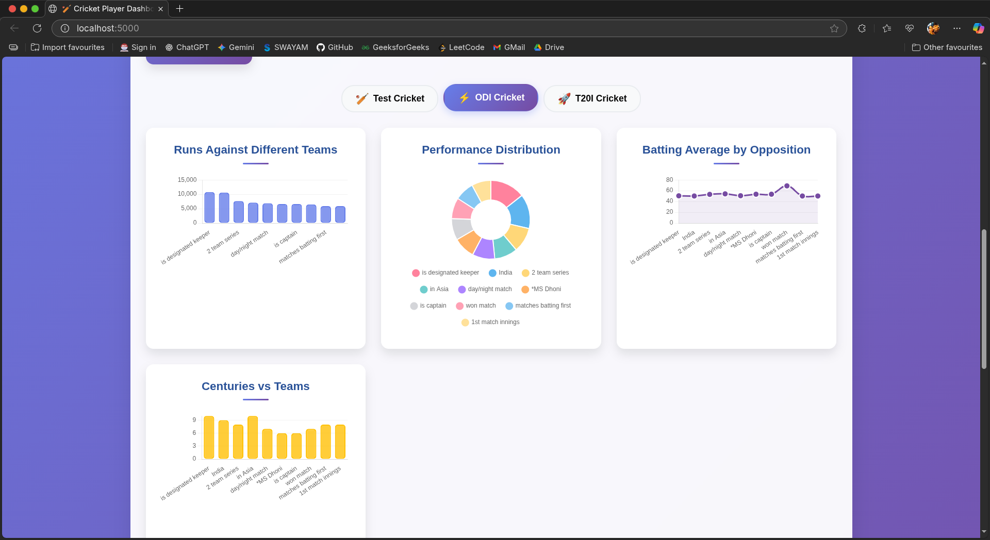

Slide 9
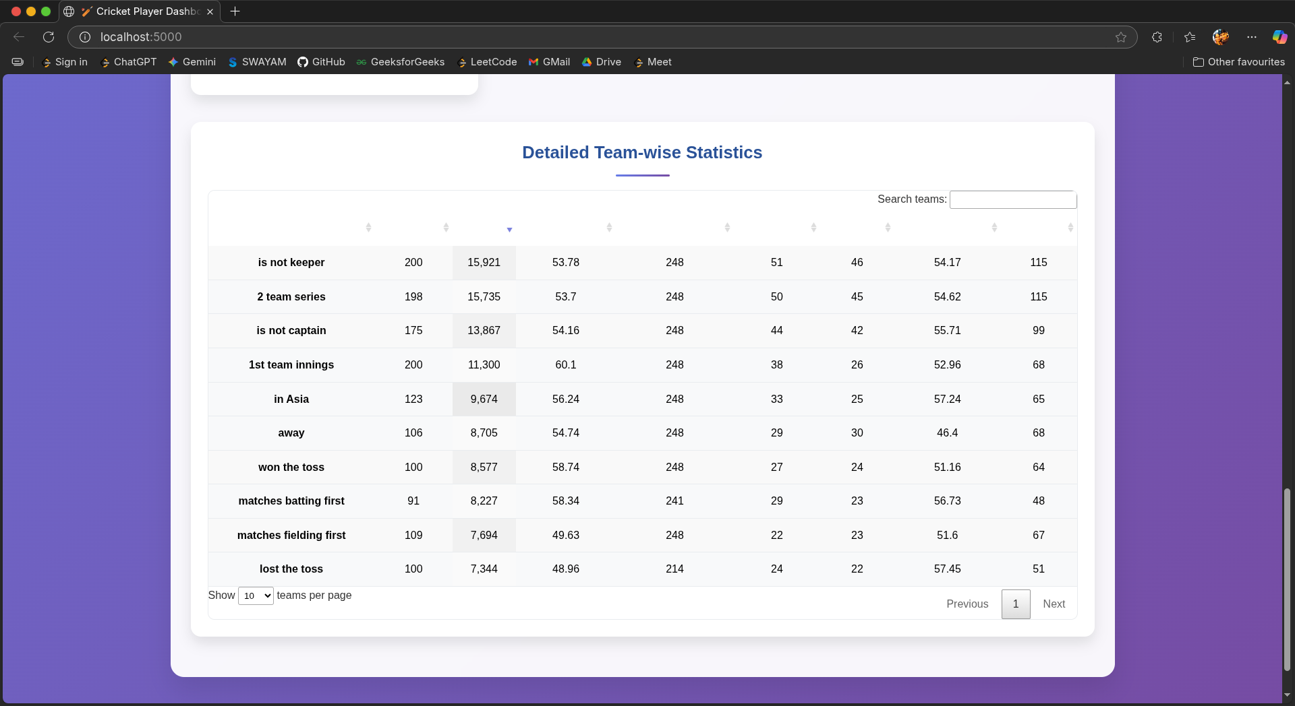

Slide 10


Project Overview
The Cricket Dashboard Project is a comprehensive data visualization tool designed to provide real-time insights into cricket statistics, enhancing the fan experience and improving data accessibility.

Slide 11
Project Structure
The project structure is meticulously organized to ensure scalability and maintainability, with a clear folder breakdown that enhances collaboration and efficiency for developers working on the Cricket Dashboard Project.
Criclytics
Cricguru
Backend
Frontend

Slide 12


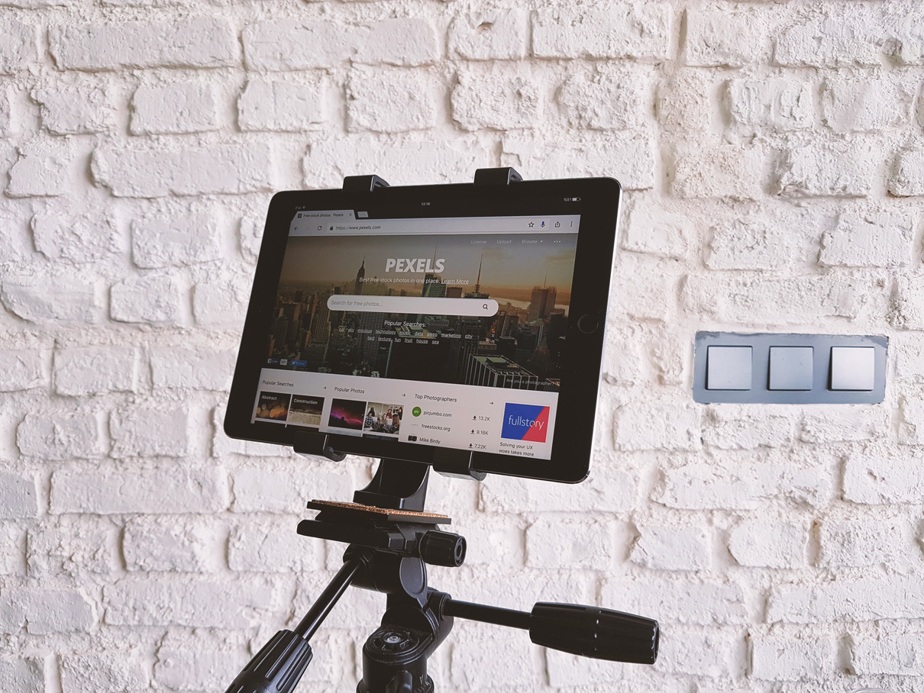
Frontend Features
Desktop View
Tablet View
Mobile View
Designed for optimal user experience on larger screens.
Responsive layout that adapts beautifully to mid-sized devices.
Fully functional interface suitable for on-the-go access.

Slide 13

Frontend Features of Cricket Dashboard
Loading States for smooth user experience
Error Handling to manage unexpected issues
Smooth Animations to enhance interactions
Interactive Elements that engage users effectively

Slide 14



Backend Features
Python 3.8+
Flask
Pandas
Latest version for modern data processing tasks.
A lightweight framework designed for building web applications.
Efficient data manipulation and analysis tools resource sharing in web applications.

Slide 15
Backend Features Overview
Key libraries used for data processing and scraping
Pandas: Efficient data manipulation and analysis tools
BeautifulSoup4: Simplifies web scraping with HTML parsing
Flask: Lightweight framework for building web applications
Flask-CORS: Handles Cross-Origin Resource Sharing for APIs

Slide 16

Data Source
The Cricket Dashboard Project relies on reliable data from ESPN Cricinfo and the cricguru package, ensuring accurate and up-to-date cricket statistics for users and developers alike.

Slide 17
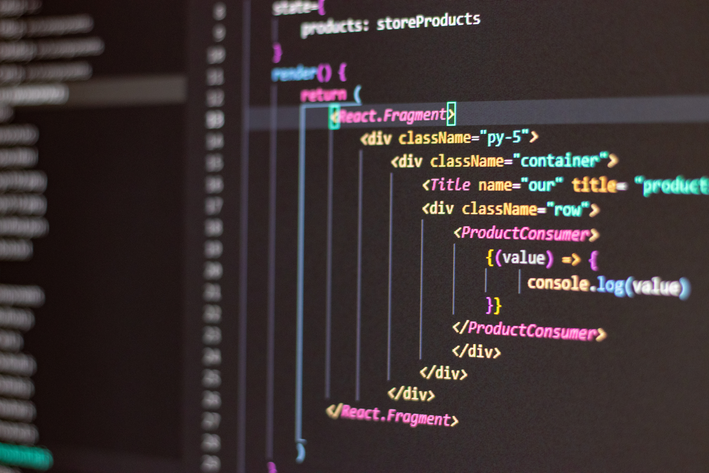
Cricguru
The Core Module ensures efficient and robust data handling through web scraping, player stats extraction, and data validation, supporting multiple formats and encapsulation for seamless performance.

Slide 18
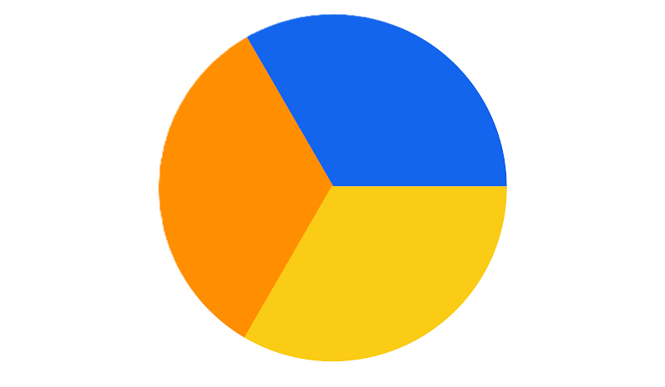
Technology Stack
Frontend
Backend
HTML
CSS
Javascript
ChartJS
Python
Flask
Flask-CORS
JSONify
Cricguru
Python
Requests
BeautifulSoup4
Pandas

Slide 19

Streamlined Workflow
Visualizing the process from frontend request to data visualization
Frontend
Sends Requests for a Player ID using JSON
Backend
Gets the Request through Flask-CORS
Cricguru
BeautifulSoup4 enables easy web scraping for dynamic data extraction.

Slide 20
Streamlined Workflow
Efficient data processes for seamless delivery and visualization across devices
Data Processing
Pandas simplifies data manipulation and analysis in Python.
Backend
Flask sends the Data in a clean JSON Response
Visualization
ChartJS enables easy visuals for dynamic data visualization.

Slide 21
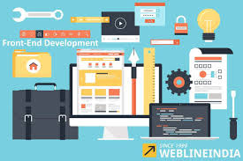
Responsive Design
Our responsive design ensures a seamless experience across all devices, providing consistent access to the Cricket Dashboard Project on desktops, tablets, and mobile devices without compromising functionality.

Slide 22
Future Enhancements for Cricklytics
Expanding the Dashboard's Capabilities for Users
Player name lookup and autocomplete feature
Historical performance trends for deeper insights
Team comparison features for competitive analysis
Match-by-match statistics for real-time tracking

Slide 23
Future Enhancements for Cricklytics
Exciting features to improve user experience and engagement
Export functionality for user data and reports
Real-time score updates for live matches
Social sharing capabilities for instant updates
Player name lookup and autocomplete options

Slide 24

Thank You
We appreciate your support!

